Slide 1
BEHIND THE DOORS
A look inside local smoke and vape shops
Charisma Dixon, Department of Behavioral Health and Developmental Services
Notes:
In this short presentation we will discussion some of the new trends appearing in local Vape and Smoke Shops. How do these changes affect children, families, communities, and your work?

Slide 2
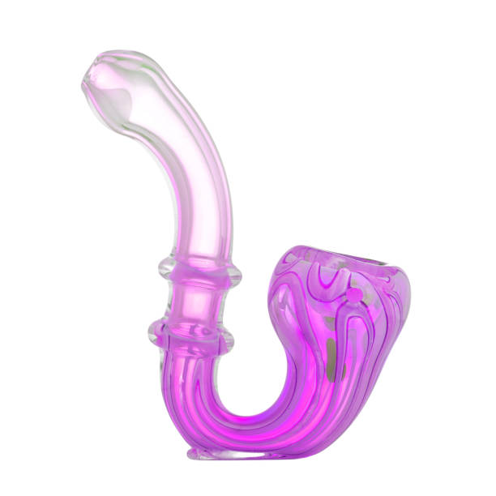
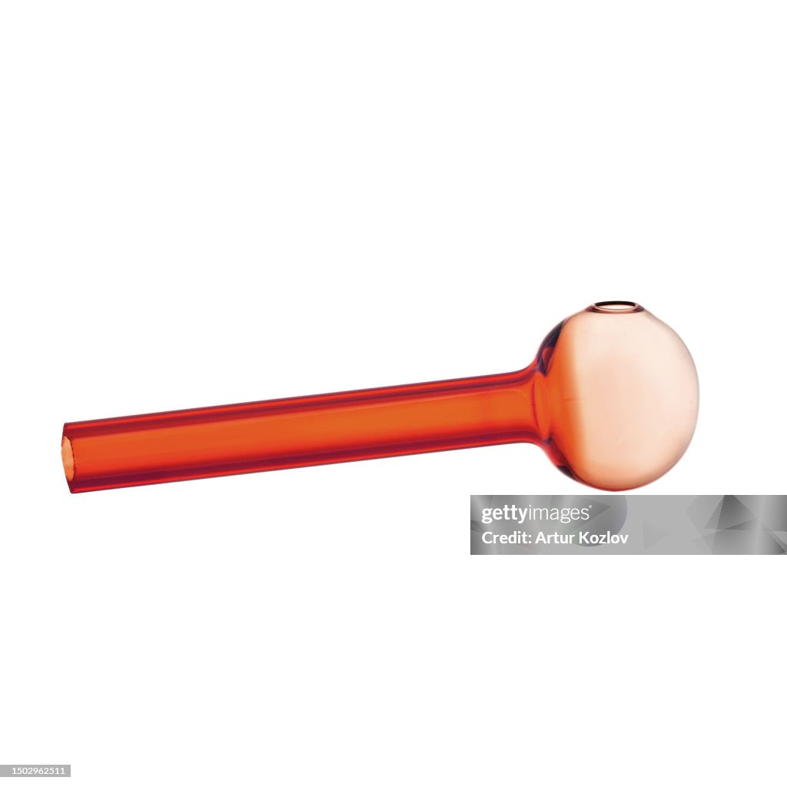
Notes:
Most vape and smoke shops are selling more than tobacco and vape devices. They are activity selling more items that are for other drug use for example glass pipes.

Slide 3
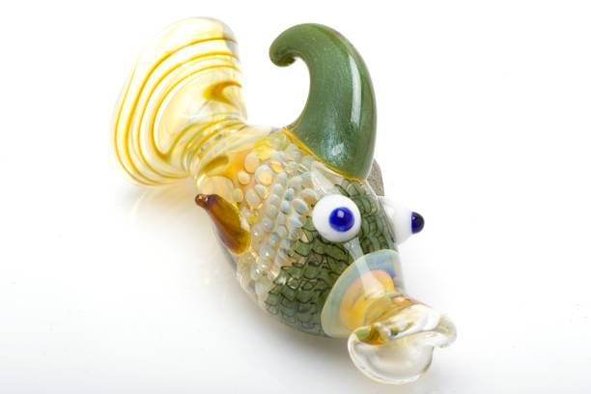
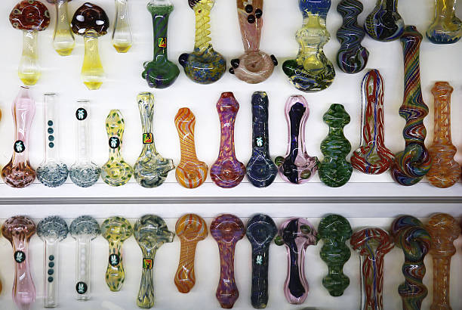
Notes:
These glass pipes are not just used for Cannabis but also for Crack and several of the shops visited had these in jars in easy reach, in different shapes including Yoda and Sponge Bob

Slide 4
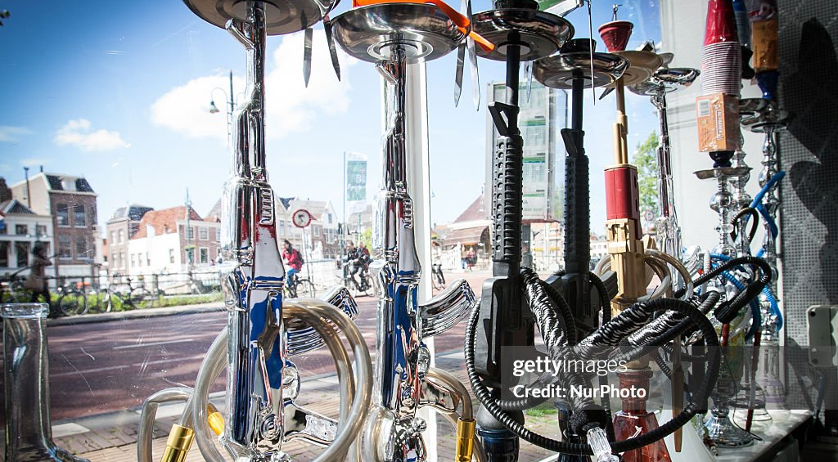
Notes:
Finally, there are lots of Hookah’s in different colors and elaborate shapes, hookahs are traditionally Arabic smoking experience that has become a trend in America.

Slide 5
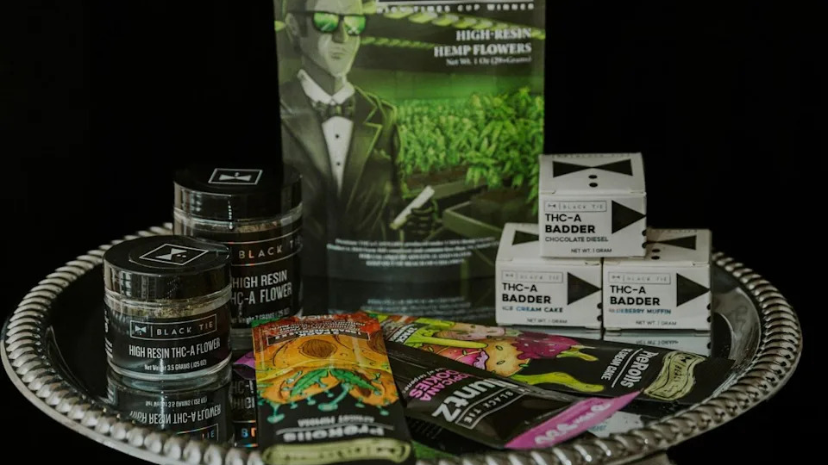
Notes:
I have noticed that some vape shops are selling pre rolled, that have THC-A with Stative. In its non heated form, there is no psychoactive effects i.e. high but when smoked or vaped THC becomes active as well as the stative form. THC-A (tetrahydrocannabinol acid) is a cannabinoid in the raw, unheated cannabis plants It is the precursor to THC (tetrahydrocannabinol).

Slide 6
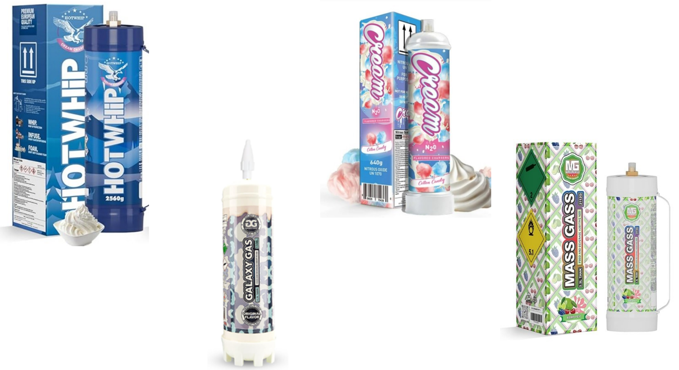
Notes:
Nitrous oxide: laughing gas, discovered in the 1700’s used for anesthetic created even then euphoria and dizziness. Upper class English in the 1800’s would go on to have laughing gas parties for fun. Nitrous gas however is a psychoactive compound that works on the brain depriving it of oxygen, altering your mental state and if used enough will damage nerves. This gas can quickly become addictive and easy to use there isn’t anything to eat, or smoke. You just breathe. Vape and smoke shops are now selling this drug in flavors for as much as $ 150.00

Slide 7
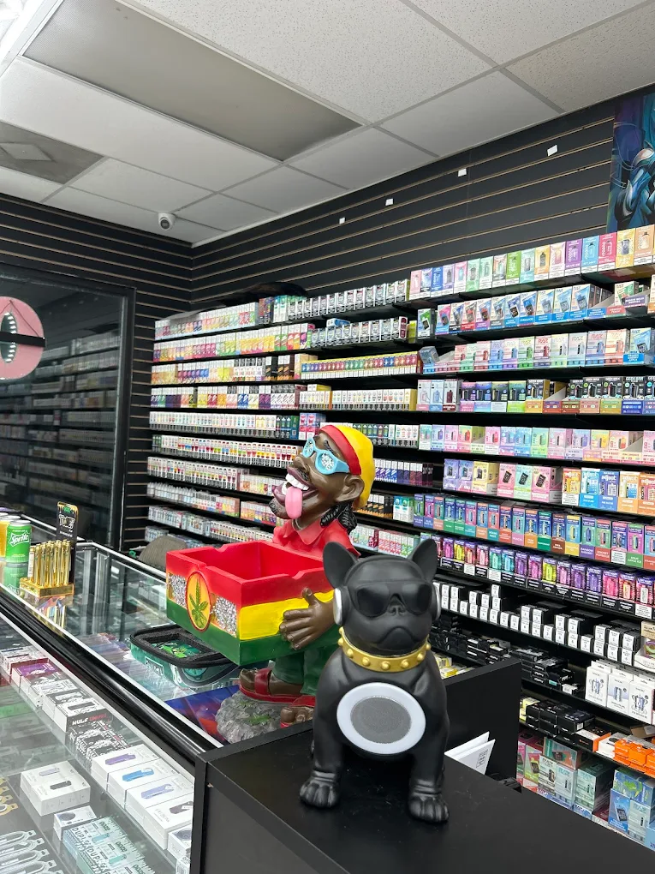
Notes:
EZ Smok Tabacco & Vape at 12608 Warwick Blvd Newport News VA open 24 hours. Known for having the best prices.

